Slide 1

Tachyon Frontend Role - Task 2
Raghul R
Frontend Developer Role
Topics Implemented: 1, 2, 3 & 4
Project Management Dashboard

Slide 2
Topics Covered - All 4 Offline Exercises
Responsive React Dashboard – Dynamic data-driven views using a mock REST API. Reusable React Components – Modular, scalable UI elements with props and styles.
Unit & Integration Testing – Robust test coverage with Jest & React Testing Library.
E2E Testing with Playwright – Automated real-user workflows across the app.

Slide 3
Technology Stack
Frontend Framework:
• React 19 with Hooks
• React Router 7
• Modern JavaScript (ES6+)
• Functional components
Styling & UI:
• Tailwind CSS 3.4
• shadcn/ui component library
• Lucide React icons
• Responsive design patterns
Testing Tools:
• Jest for unit testing
• React Testing Library
• Playwright for E2E tests
• Comprehensive test coverage
Development Tools:
• Create React App (CRA)
• Axios for API calls
• Mock API for development
• Hot reload enabled

Slide 4
Project Overview - ProjectHub
Core Features:
• Dashboard View: Overview statistics, active projects, budget tracking.
• Projects Management: Card layout with search, filters, progress tracking.
• Tasks Board: Kanban-style with To Do, In Progress, Completed columns.
• Team Management: Member cards with roles, stats, contact info.
• Analytics: Weekly progress, status distribution, budget utilization.
Design Philosophy:
• Apple-inspired clean and minimal interface.
• Professional blue-gray color palette.
• Generous whitespace for luxury feel.
• Smooth animations and hover states.
• Mobile-first responsive design.

Slide 5
Topic 1: Responsive React Dashboard
• Fully responsive React dashboard for desktop, tablet, and mobile • Displays live project, task, and analytics data via mock REST APIs • Modular functional components using React Hooks for dynamic state management • Interactive project cards, task lists, and charts with real-time progress updates • Filters, sorting, and search functionality for seamless navigation
Mock API Structure (src/mock.js)
export const mockApi = {
getProjects: async () => { /* Returns 5 projects */ },
getTasks: async () => { /* Returns 7 tasks */ },
getTeam: async () => { /* Returns 6 members */ },
getAnalytics: async () => { /* Returns stats */ }
};
// Sample Project Data
{
id: 1,
name: "Website Redesign",
status: "In Progress",
progress: 65,
budget: 50000,
spent: 32500,
team: ["John", "Sarah", "Mike"]
}

Slide 6
Topic 1: Responsive Design
Dashboard Page Implementation
Key Points Highlighted in Code:
• Uses React Hooks (useState, useEffect) for state and side-effects.
• Fetches analytics data asynchronously from a mock API.
• Implements a modular component structure: StatCards, ActiveProjects, BudgetOverview.
• Clean JSX structure with spacing utility classes for layout.
const Dashboard = () => {
const [stats, setStats] = useState(null);
const [loading, setLoading] = useState(true);
useEffect(() => {
const loadData = async () => {
const data = await mockApi.getAnalytics();
setStats(data);
setLoading(false);
};
loadData();
}, []);
return (
<div className="space-y-6">
<StatCards data={stats} />
<ActiveProjects />
<BudgetOverview />
</div>
);
};
Outcome: Clear, maintainable dashboard implementation with responsive design

Slide 7
Topic 2: Reusable Components
Built a library of reusable React components to ensure consistency, scalability, and efficient development across the application.
Main Components Developed: ProjectCard – Displays project details such as name, status, progress, and budget usage.
TaskCard – Represents individual tasks with title, assignee, priority indicator, and due date.
StatCard – Shows key performance metrics with icons, trend indicators, and responsive layout.
Key Advantages: • Promotes consistent UI styling across all pages. • Enhances code reusability and reduces duplication. • Simplifies maintenance and scalability as the app grows. • Ensures clean structure and faster component-level testing.

Slide 8
Topic 3: Unit & Integration Tests
Comprehensive Unit and Integration Testing was performed using Jest and React Testing Library to ensure full functionality across all components and pages.
Test Coverage: • Component Tests: All reusable UI components validated for rendering and props. • Page Tests: Dashboard, Projects, Tasks, Team, and Analytics pages verified for data and layout. • User Interactions: Simulated clicks, filters, searches, and form actions. • API Integration: Tested mock API calls and responses for accuracy. • Navigation: Confirmed router functionality and seamless page transitions.
Running Tests:
# Run all tests-yarn test
# Run with coverage report-yarn test --coverage
# Run in watch mode-yarn test –watch
Test Results: • All component, page, and integration tests passed successfully • Achieved high code coverage and stable UI performance • Ensured robust, bug-free, and production-ready frontend

Slide 9
Topic 4: E2E Testing with Playwright
Example: Dashboard E2E Test
import { test, expect } from '@playwright/test';
test.describe('Dashboard Page', () => {
test('displays all elements', async ({ page }) => {
await page.goto('http://localhost:3000');
// Check heading
await expect(page.getByRole('heading',
{ name: /dashboard/i })).toBeVisible();
// Check stat cards
await expect(page.getByText('Total Projects'))
.toBeVisible();
await expect(page.getByText('Active Tasks'))
.toBeVisible();
// Verify project cards
const cards = page.locator('.project-card');
await expect(cards).toHaveCount(3);
});
});
Key Points Highlighted in Code:
• Uses Playwright to simulate real user interactions on the Dashboard. • Navigates to the app and verifies heading and stat cards visibility. • Checks that project cards are rendered correctly (project-card). • Ensures UI consistency and correct data rendering through automated E2E tests.
Outcome: Reliable end-to-end validation of the Dashboard page, ensuring that all key elements render and behave correctly for the user.

Slide 10
Complete E2E Test Suite
Implemented End-to-End (E2E) testing using Playwright to simulate real user workflows and ensure complete application reliability.
E2E Test Coverage: • Dashboard Tests: Verified all statistic cards and project data rendering. • Navigation Tests: Ensured smooth sidebar transitions and active link states. • Projects Tests: Checked search, filter, and project detail interactions. • Tasks Tests: Validated Kanban board layout and task movement across columns.
Running E2E Tests:
# Install browsers (first time setup)-npx playwright install
# Run all E2E tests-npx playwright test
# Run tests in UI mode-npx playwright test --ui
# Generate HTML report-npx playwright show-report
Test Results: • All E2E test cases passed successfully • Verified end-to-end workflows across modules • Achieved stable performance and consistent UI behavior

Slide 11
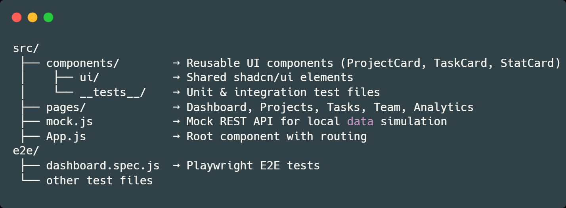
Project Architecture & Design
Explanation:
• components/ – Contains all reusable and modular UI blocks. • pages/ – Each page represents a route in the dashboard (e.g., /dashboard, /projects). • mock.js – Simulates API responses for testing and local development. • App.js – Manages routing and renders page layouts using React Router. • e2e/ – Stores Playwright-based end-to-end tests for user flow validation.
Design Principles : • Minimal & Elegant: Inspired by Apple-style simplicity and focus. • Consistent Visual Language: Unified blue-gray color palette for a professional tone. • Whitespace & Clarity: Enhanced readability with generous spacing. • Smooth Interactions: Subtle animations and hover states for an engaging feel. • Responsive & Accessible: Adaptive layouts optimized for all screen sizes and devices.

Slide 12
Testing and Validation
Component Testing: Ensured reliable rendering and behavior of reusable React components.
Page Validation: Verified routing, layout responsiveness, and accurate data display.
User Interaction: Tested real user actions for smooth navigation and UI feedback.
API Integration: Used mock APIs to validate async data fetching and accuracy.
End-to-End (E2E): Automated complete user flow validation using Playwright.
Result: All components and pages passed both functional and E2E tests — ensuring a stable, responsive, and reliable dashboard application.

Slide 13
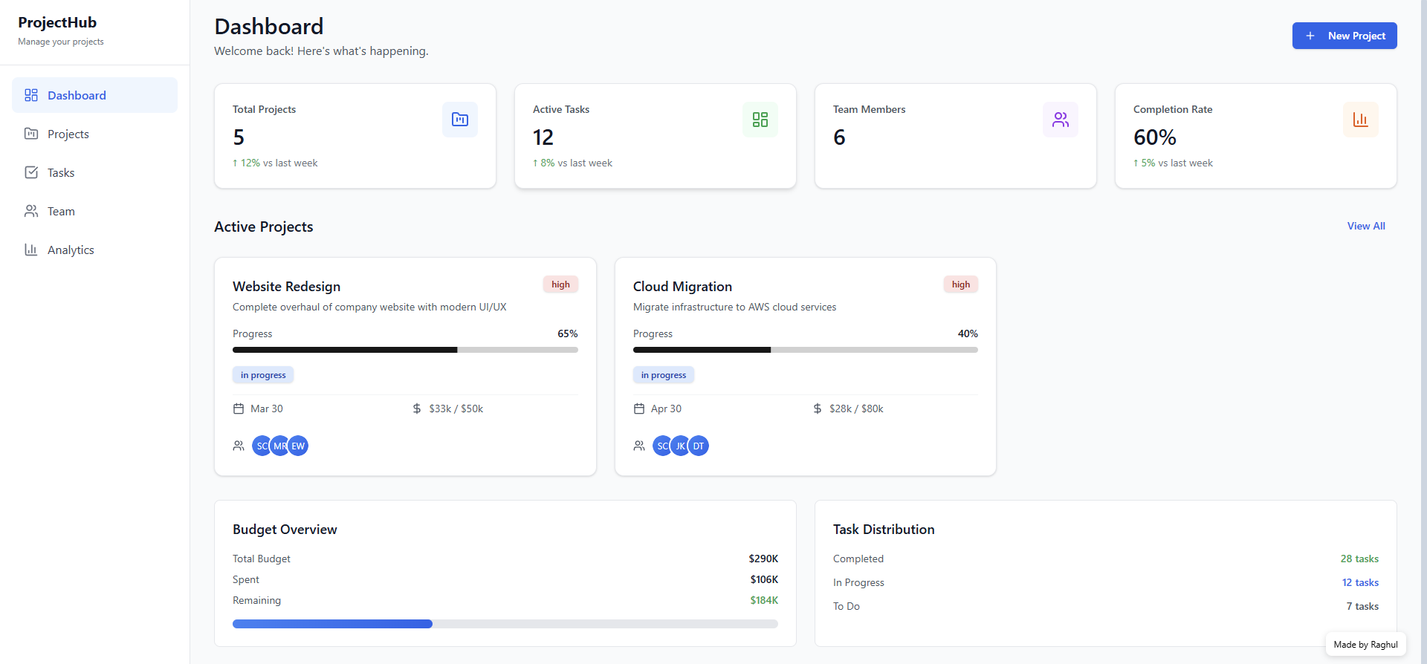
Project Screenshot
Dashboard Page: Provides an overview of total projects, tasks, team members, and progress metrics at a glance.

Slide 14
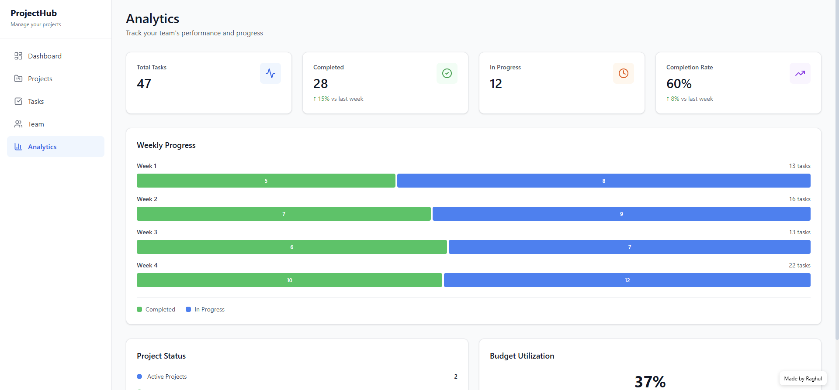
Project Screenshot
Analytics Page: Displays detailed team performance insights, weekly progress, and budget utilization.

Slide 15
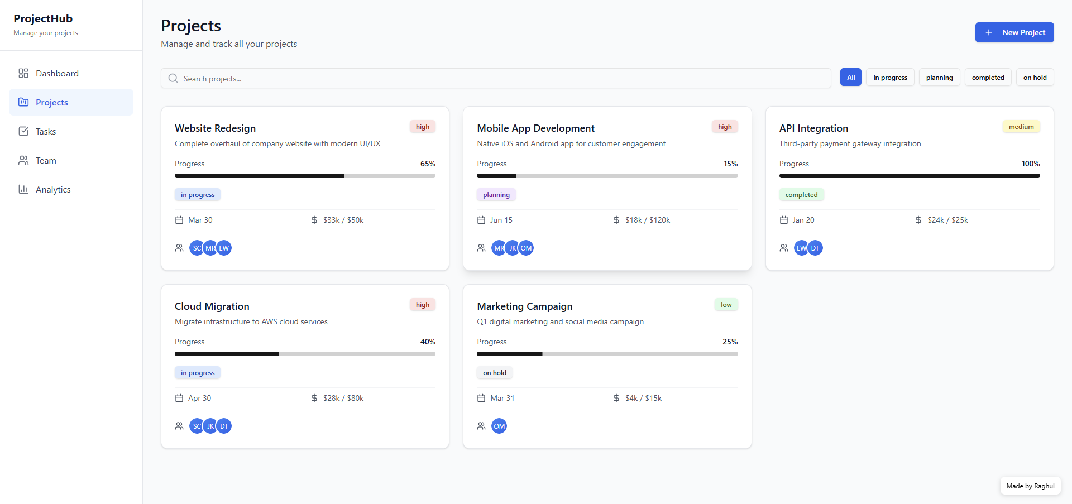
Project Screenshot
Projects Page: Lists and tracks all ongoing, planned, completed, and on-hold projects with progress and budget details.

Slide 16
Key Highlights & Features
A complete frontend project integrating all four core topics — designed, developed, and tested for real-world production readiness.
Technical Accomplishments:
Responsive React Dashboard with mock REST API and real-time data management.
Reusable Component Library ensuring modularity and scalability.
Comprehensive Testing Suite (Jest + React Testing Library) with high coverage.
Playwright E2E Automation validating full user workflows and navigation.
UI/UX Excellence: • Apple-inspired clean and minimal interface. • Smooth animations and intuitive hover effects. • Fully responsive and accessible design for all devices.
Production Readiness: • Optimized performance with efficient React patterns. • Mock API architecture ready for backend integration. • Clean, maintainable, and scalable codebase. • Complete test validation ensuring stability and reliability.

Slide 17
Conclusion
• The Responsive React Dashboard successfully demonstrates modern frontend practices using React, Hooks, and modular components. • It ensures a seamless user experience across devices with real-time data visualization and interaction. • Through component, API, and E2E testing (Playwright), the application achieves high reliability and maintainability. • This project reflects strong understanding of frontend development, testing workflows, and scalable UI design. • Future upgrades will focus on real-time integration, analytics, and automation for production-level deployment.
Final Note: This project showcases a complete end-to-end frontend solution — from responsive design and modular implementation to automated testing and future scalability.

Slide 18
Thank You!
GitHub Repository
https://github.com/raghul1020/Tachyon-Frontend-Task2.git
✅ Complete source code for all 4 topics
✅ Unit tests (Jest + React Testing Library)
✅ E2E tests (Playwright)
Raghul R
Frontend Developer Role | Tachyon Systems - Freshers Recruitment 2025

